Slide 1
CSS Layouts
CSS layouts are critical for creating structured and visually appealing web pages. They enable you to define the arrangement and alignment of content.

Slide 2
The most used CSS layout techniques are
Normal Flow Layout
Float Layout
Flexbox Layout
Grid Layout
Positioning Layout
Multicolumn Layout
Table Layout
CSS Frameworks for Layouts (Optional)
Grid Layout in CSS

Slide 3
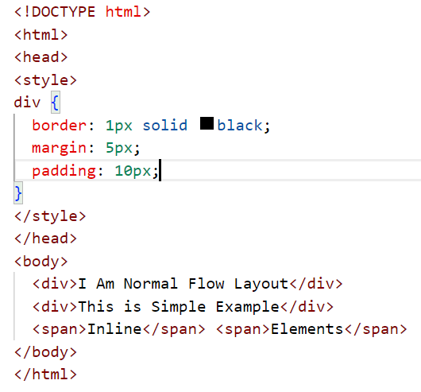
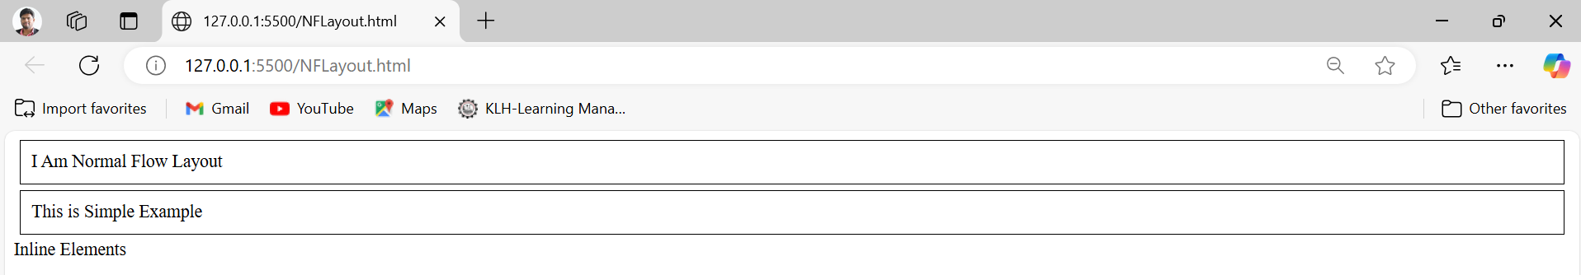
Normal Flow Layout
This is the default layout where elements are stacked vertically (block elements) or horizontally (inline elements).

Slide 4
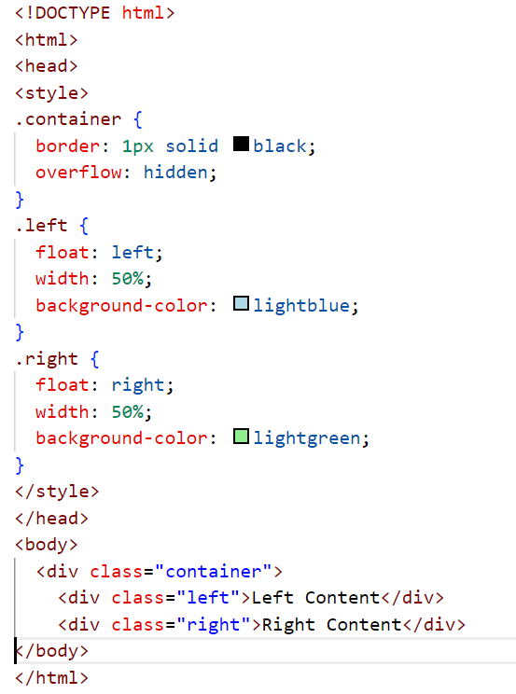
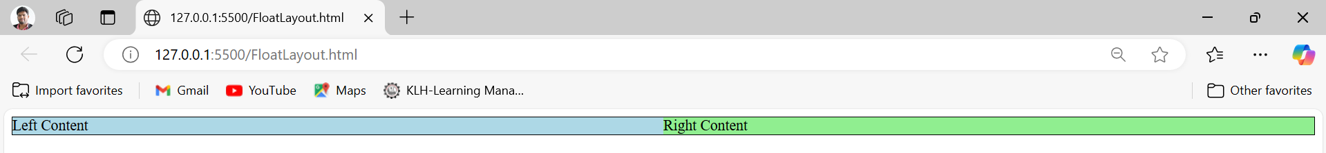
Float Layout Float is used to position elements to the left or right of their container.

Slide 5
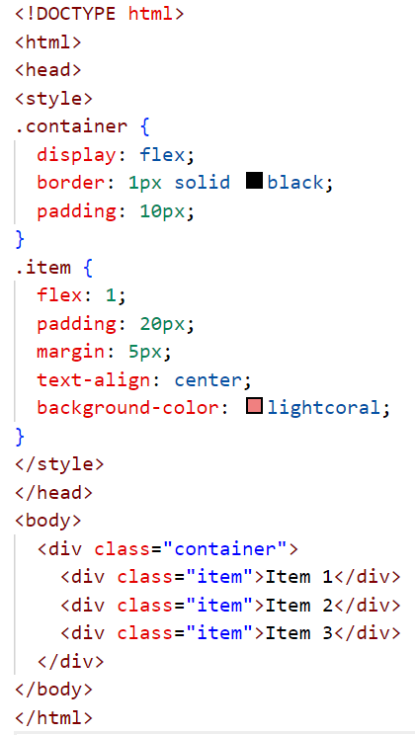
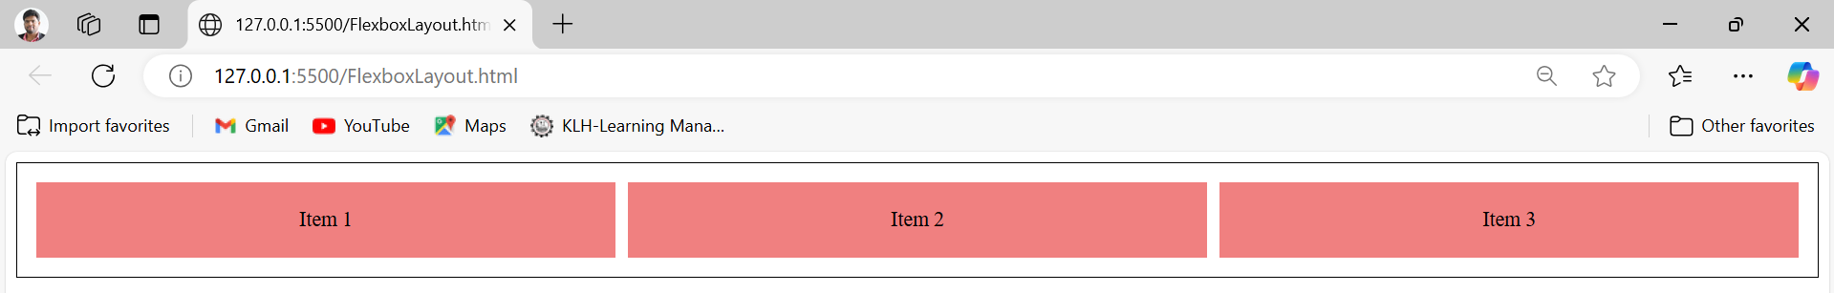
Flexbox Layout Flexbox is ideal for designing responsive and flexible layouts.

Slide 6
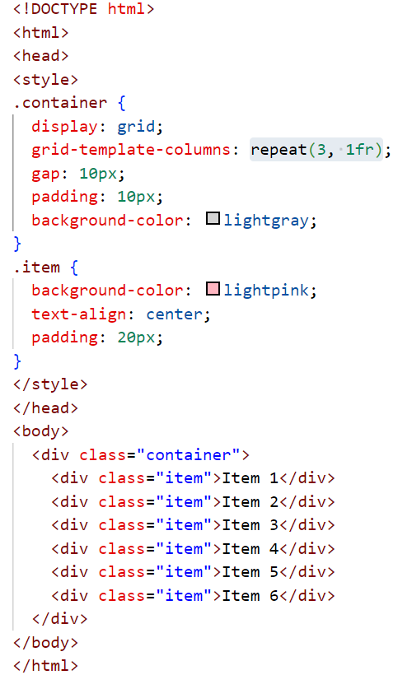
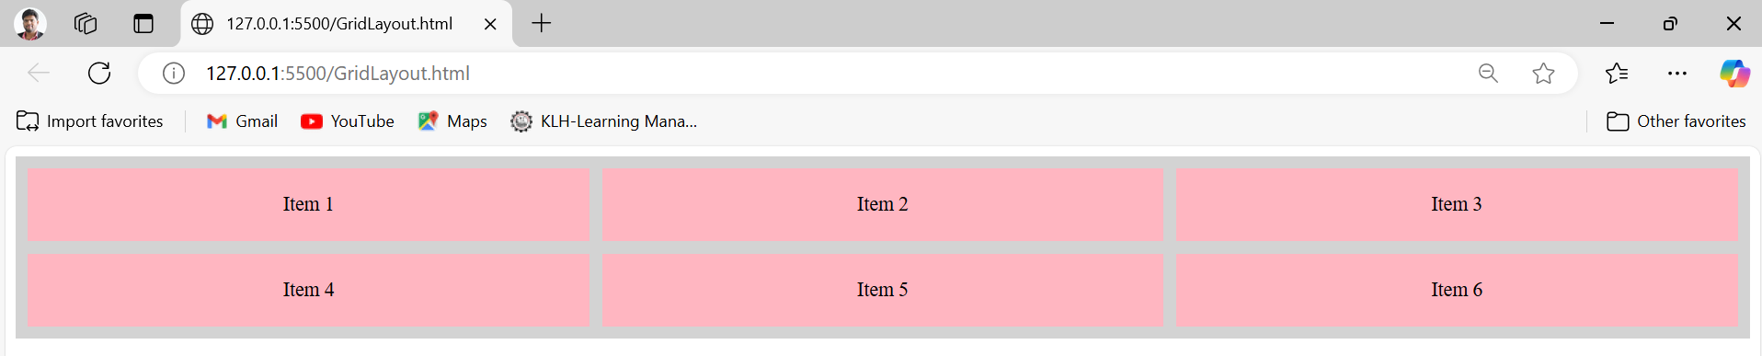
Grid Layout Grid layout is perfect for creating two-dimensional layouts.

Slide 7
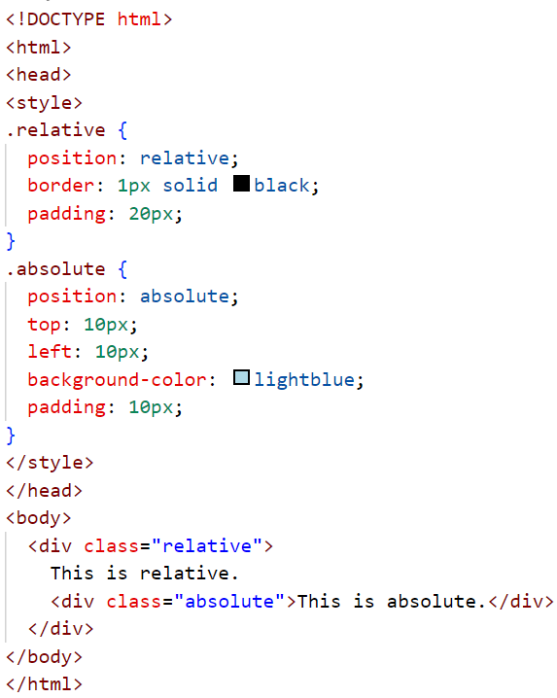
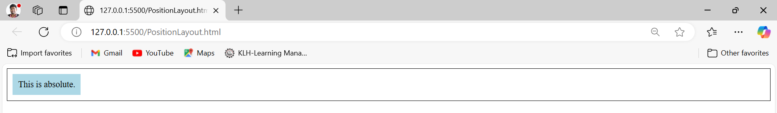
Positioning Layout
You can position elements using relative, absolute, fixed, or sticky.

Slide 8
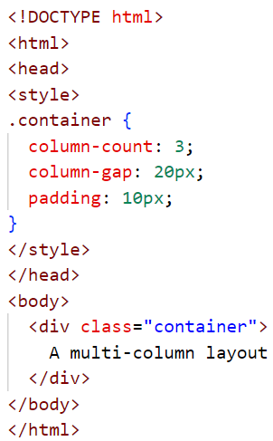
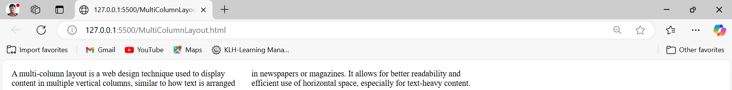
Multicolumn Layout
A multi-column layout is a web design technique used to display content in multiple vertical columns, like how text is arranged in newspapers or magazines. It allows for better readability and efficient use of horizontal space, especially for text-heavy content.

Slide 9
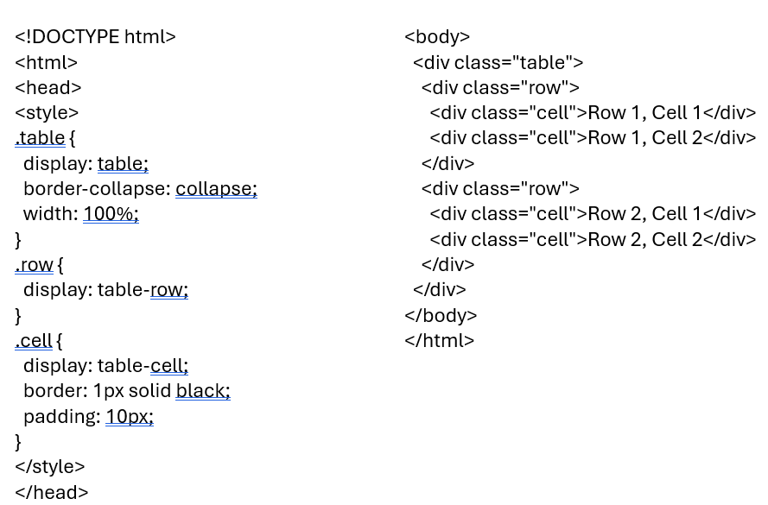
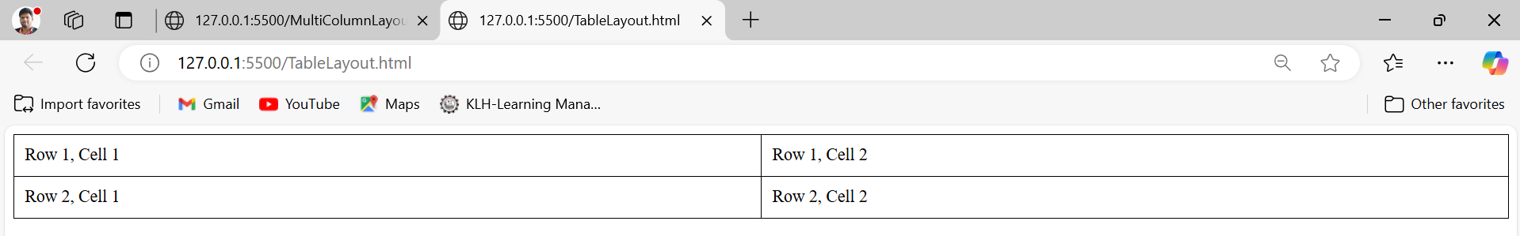
Table Layout
Table layouts use <table> elements or display: table for grid-like content.

Slide 10
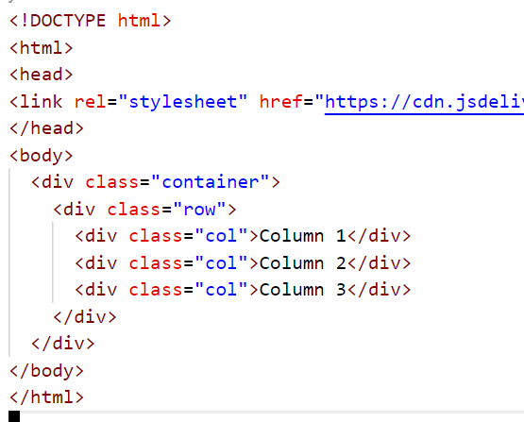
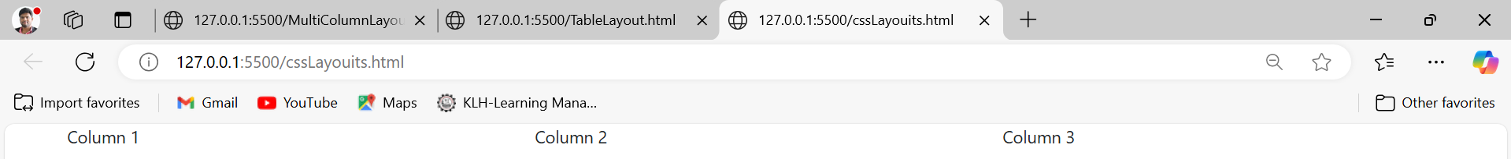
CSS Frameworks for Layouts (Optional)
Frameworks like Bootstrap
or Tailwind CSS provide pre-built
layout classes.

Slide 11
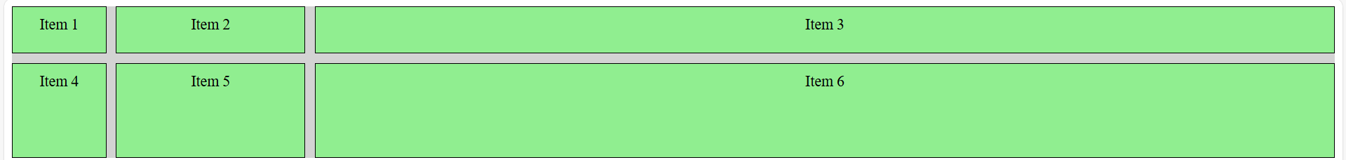
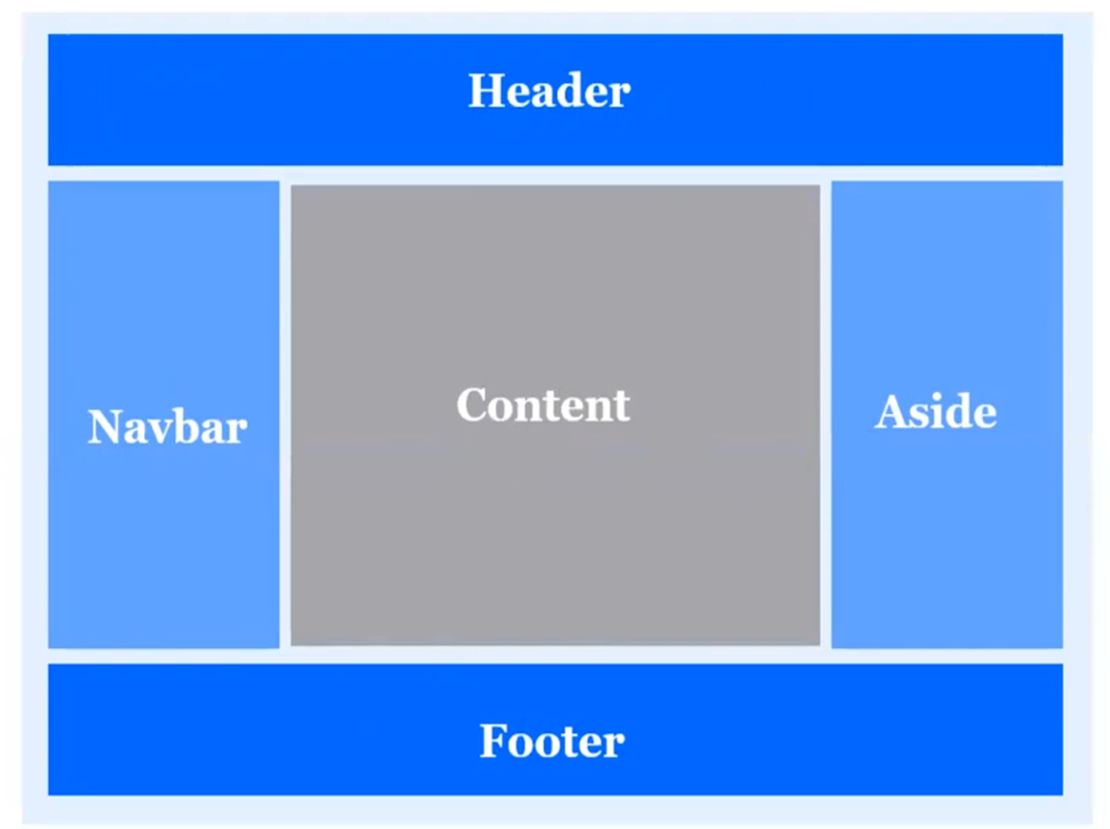
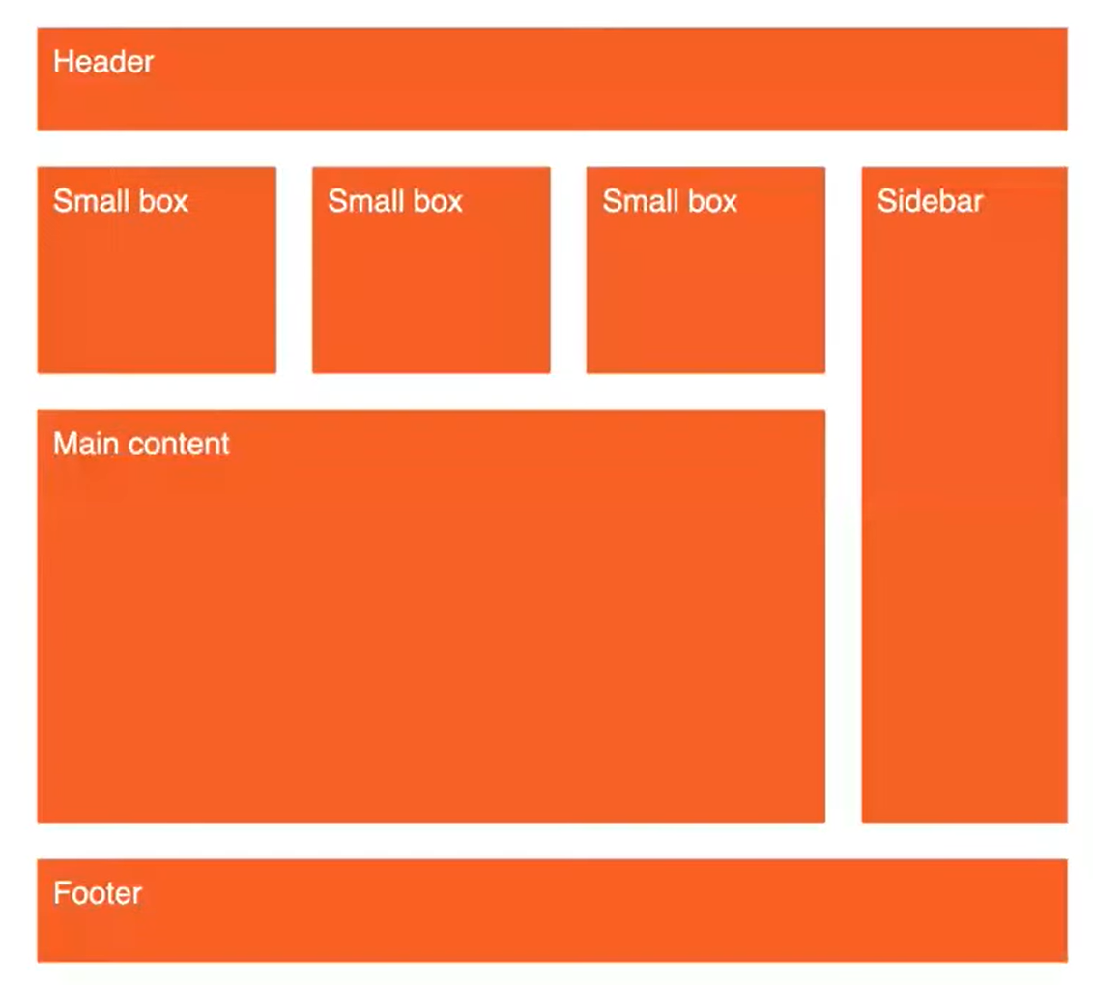
Grid Examples

